Slide 1

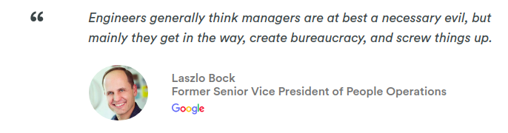
To prove this point they hired a group of statisticians to evaluate the differences between the highest and lowest rated managers. Data was collected using past performance apprther sources of employee feedback. However, instead they proved that good management actually makes a difference. To better define what makes a good manager they came up with a list of 8 qualities based on the data received.
CASE STUDY: Project Oxygen

Slide 2
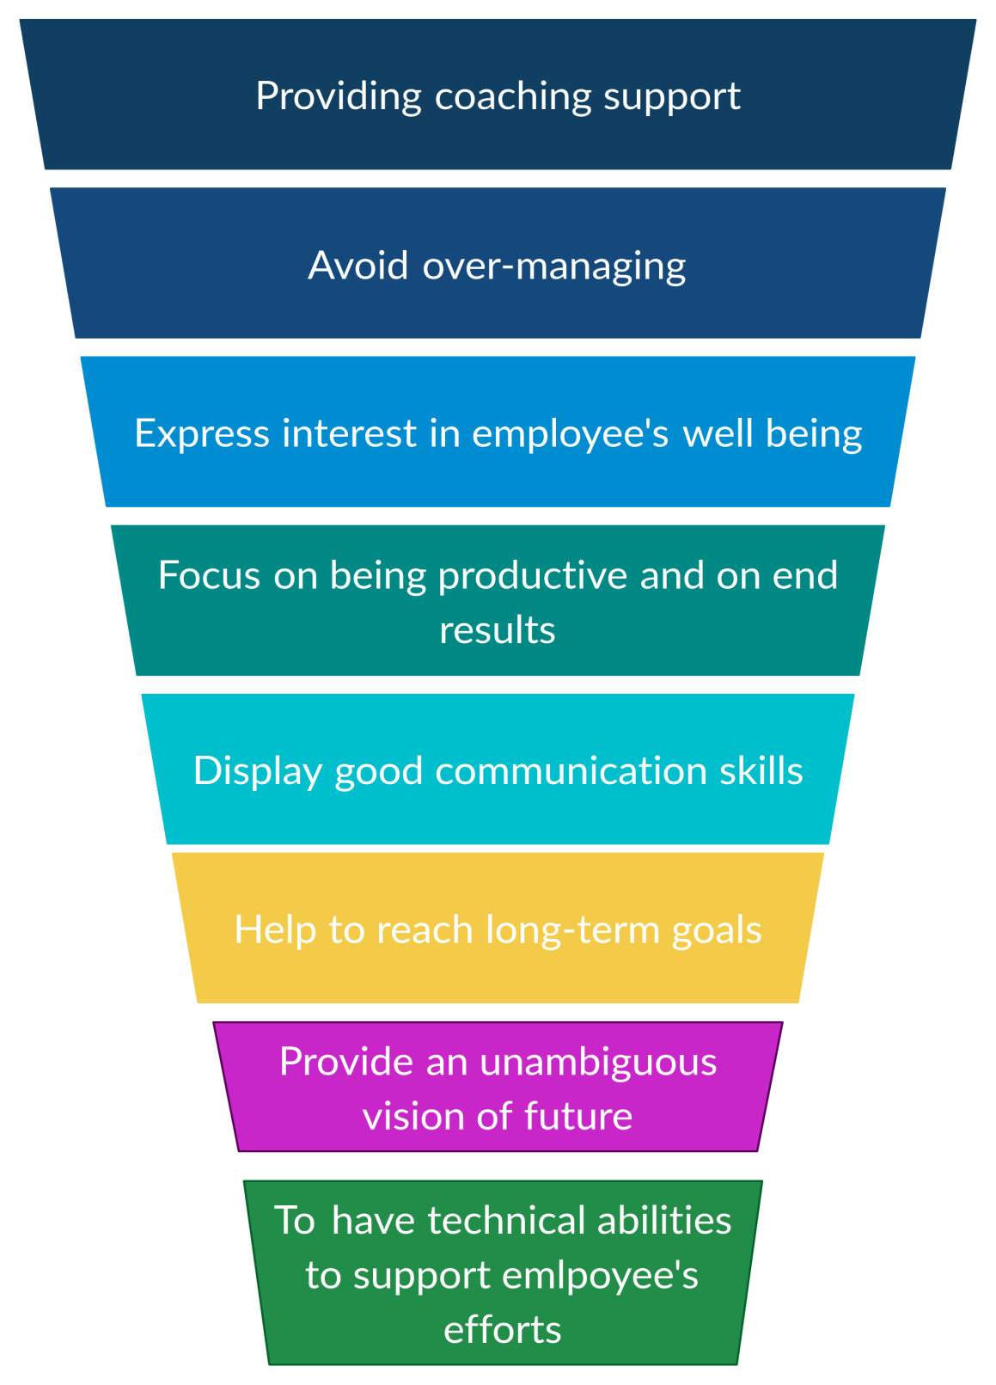
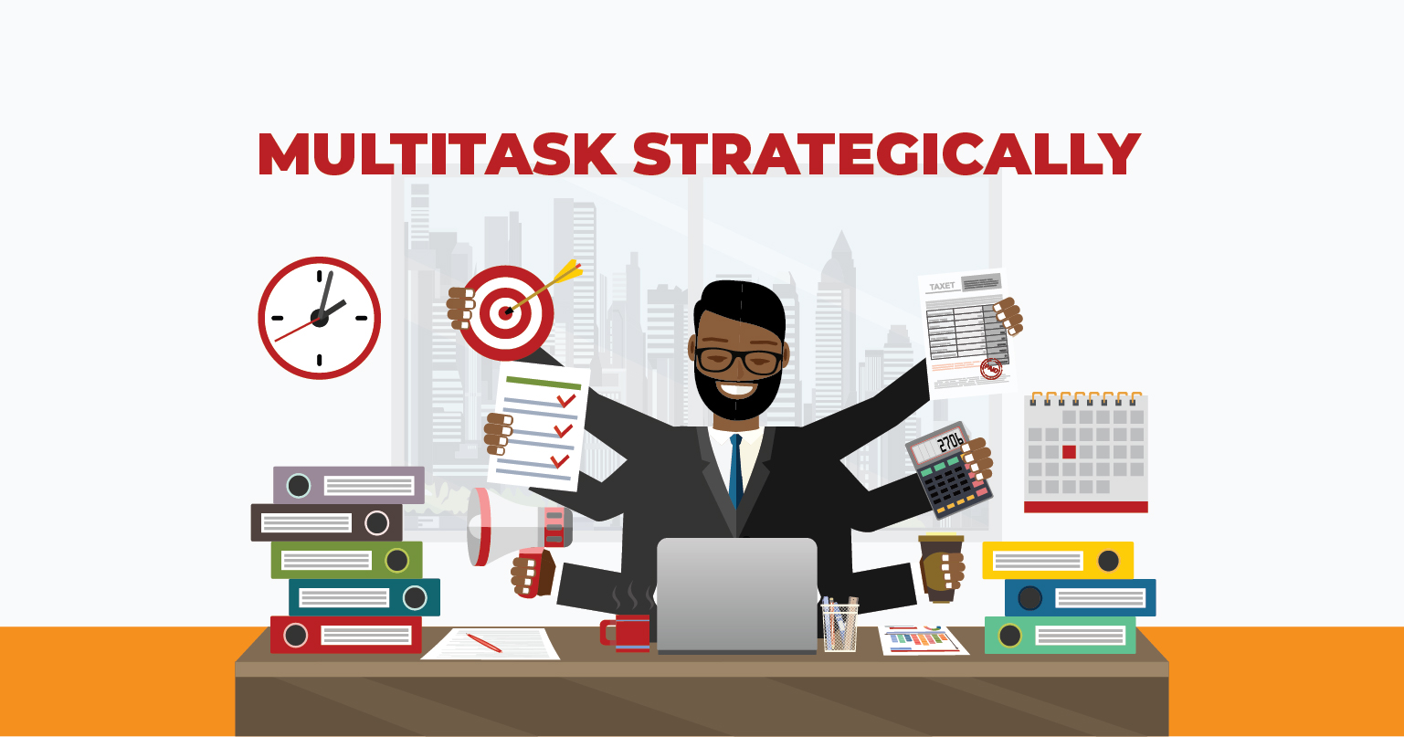

Slide 3


Good coach
Only 25% of organizations have a strong coaching culture, according to research by the International Coach Federation.
The survey found that 79% of respondents believe their workers value coaching, but many companies are not practicing this type of management.
In Daniel Goleman’s classic study of leadership styles, published magazine in 2000, leaders ranked coaching as their least-favorite style.
In fact, 92% of managers report that coaching is not part of their role expectations.
According to Harvard Business Review, “an effective manager-as-coach asks questions instead of providing answers, supports employees instead of judging them and facilitates their development instead of dictating what has to be done”.
In 2008 Google launched Project Oxygen, at the top of the list was being a good coach.
Google has seen an improvement in management at Google, as well as in team outcomes like turnover, satisfaction and performance over time.
At Google, the Managers effectively teach and advise employees on how to perform tasks, while offering constructive feedback.

Slide 4
It's important that managers teach employees HOW to think as opposed to WHAT to think.
Quickly giving them the answer may help in the short run, but playing the long game and building problem-solving skills will serve employees throughout their entire career.
Prepare and help them in building Skills.
Allow them to make “mistakes” but make them learn from that.
Provided timely and specific feedback for improvement

Slide 5


Empowers team and does not micromanage
Empowering means treating each person as a trusted individual who enjoys ownership of his or her tasks.
The second-ranked trait of good managers at Google is that they do not micromanage employees and, instead, empower their team to take control of their own work and projects.
Feedback and advice can be extremely helpful for employees.
An April 2014 study was conducted by the American Psychological Association found that when employees felt valued by their employers, 92 percent of them felt satisfied in their roles, and 91 percent said they were motivated to do their best.
Over management damages the manager-employee relationship and prevents teams from finding innovative solutions to problems or ways to finish projects.
Hence, managers need to lead and instill a sense of ownership and self-leadership among their employees.
when leaders are insistent upon things getting done their way.
No trust,
Lack of confidence,
Employees become dependent
hinders business growth

Slide 6
An empowered workforce is more engaged.
An empowered workforce is higher performing and more productive.
An empowered workforce is more aligned with an organisation’s business goals.
Partnering
HOW WILL IT ACTUALLY WORK OUT?

Slide 7
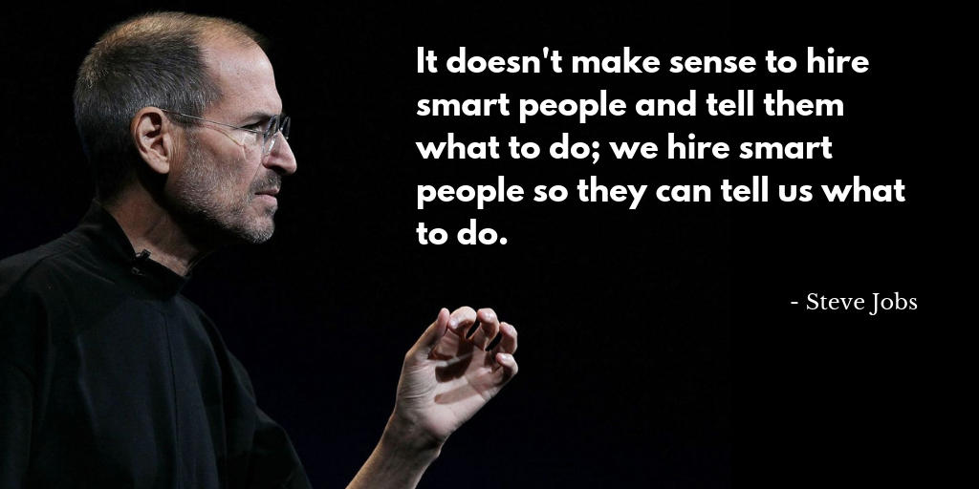

Slide 8

Express interest in employee’s well being
The recipe is simple, for a thriving business, you need thriving employees.
This is done through creating a work culture that promotes health through all aspects of their lives.
As a manager, it is your responsibility to promote employee wellbeing in the team. If the workforce is demotivated, stressed and not building positive relationships, the team’s productivity and efficiency will suffer as a result.
At Google
There are a number of grassroots organizations dedicated to de-stigmatizing mental health in the workplace and fostering a more open, connected Google through peer support, and training.
At Google, senior leaders are involved in regular open conversations with Googlers across the company.
At Accenture-
Employees get health assessments, subsidized gym memberships, confidential counseling, and health coaches. They’re encouraged to join employee-led sports and activity clubs, and there’s a big push to break down the stigmas surrounding mental health.
At Netflix-
It’s the ultimate in flexible working, and it effectively guarantees a healthy work/life balance for every member of staff.
Manage workloads
Build on employee skills
Employ effective communication
Motivate the team

Slide 9

on being productive and on end results
Focus on helping the team achieve its goals by prioritizing work and getting rid of obstacles.
A manager can make their team productive and results oriented by first providing the team members with an environment where they can productively engage in their activities that create value.
Equipping their teams with highly productive work methods (customer-focused agile workflows, automated tools, customized work units) and then establishing efficient ways to carry out work and having in place clear metrics by which team members ,outputs are measured can contribute to this factor.
A manager’s responsibility is creating clear accountabilities across team members so that individuals are clearly and uniformly accountable for what they do and fairness with which they are measured. Any arbitrariness in this critical factor can quickly demoralize the team
SUMMARIZING: focus on what you want the team to achieve and how employees can help achieve it. Help the team prioritize work, and make decisions to remove roadblocks.

Slide 10
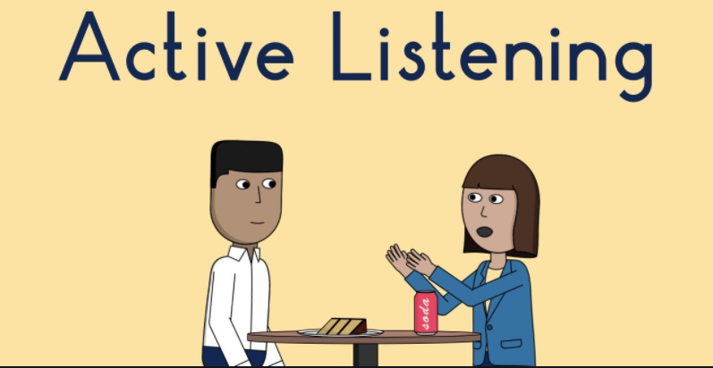

Display good communication skills, especially listening
Learn to listen and to share information; encourage open dialogue and pay attention to the team’s concern.
Effective communication doesn't happen overnight, it is a skill that has to be cultivated and nurtured.
Listening is one of the most important skills you can have. How well you listen has a major impact on your job-effectiveness, and on the quality of your relationships with others.
By becoming a better listener, you can improve your productivity, as well as your ability to influence, persuade and negotiate.
It ultimately leads to avoid conflict and misunderstandings. All of these are necessary for workplace success!
Pay attention
Provide feedback
Respond appropriately
Avoid interruptions
Withhold judgements
****ACTIVE LISTENING****

Slide 11

HELP INDIVIDUALS REACH THEIR LONG-TERM WORK GOALS
The most powerful conversations you can have as a manager with a team member is about their goals.
Noticing the employee’s efforts and make their appreciation known.
Managers mention that their career success matters to the organization.
If you trust them by sharing your goals, they are more likely to share their goals. This is the reciprocity principle.
Managers find ways to spark up the conversations and make them reach the long term goal.
Focusing on one-on-ones development.
Motivating them to achieve more.
Connecting employee goals to larger company goals.
According to a 2012 study by The Alliance,”75% of employees say that they’re willing to use their own time to further their careers and take on additional learning that would benefit them at work.”

Slide 12
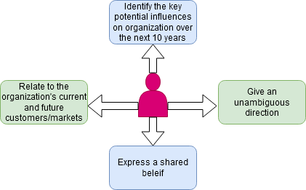
PROVIDE UNAMBIGUOUS VISION OF FUTURE
It’s one of the few facts in business, “Without a clear and compelling strategy, your business will fail”
The best managers find ways to provide steady, realistic direction and to lead with excellence, even when the strategy isn’t clear.
Vision is an expression of what the organization wants to become, what it wants to be, to be known as or to be known for.
When the strategy is uncertain, the best managers acknowledge what’s unknown, but also look ahead to what is known and what is likely to happen.

Slide 13
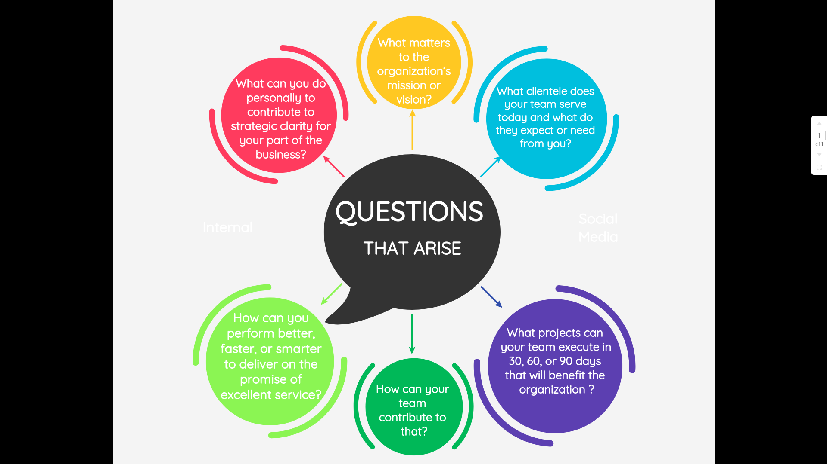

Slide 14
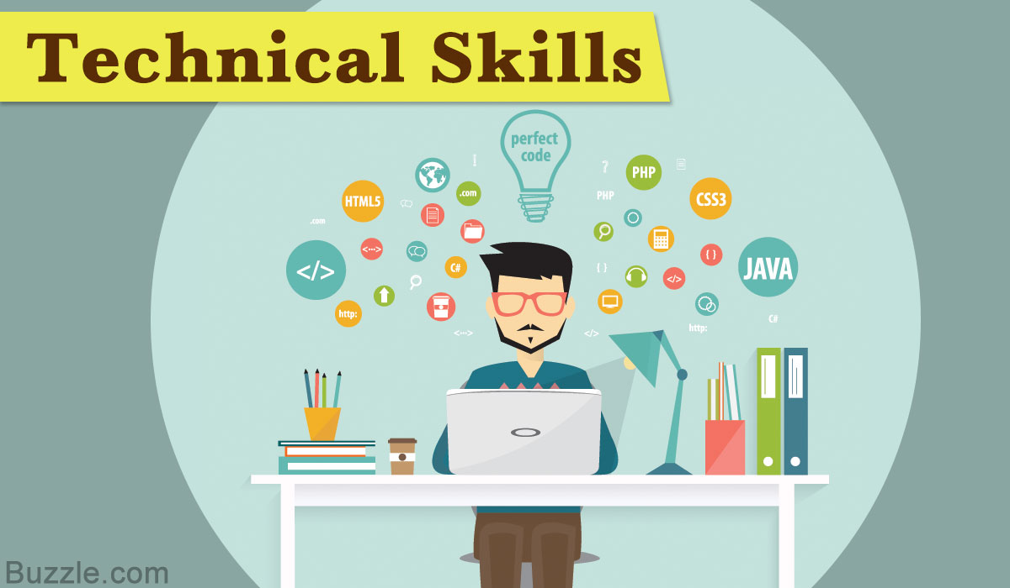

ENSURE YOU HAVE NECESSARY TECHNICAL ABILITIES TO SUPPORT EMPLOYEE EFFORTS
This skill came in last place on the Google’s list.
Great employees don’t always make the best managers - some engineers may prefer to focus on their work.
You have to have patience, great communication skills, the ability to see the big picture.
Lower level managers must have technical skills.
For managers at higher levels, the technical skills are not that important.
In this world of competition,the manager should have the necessary skills in order to support the employee efforts and also to be ahead in this fast racing world.
To be knowledgeable about the system and technologies the engineer is working with and offer input for design dilemmas.

Slide 15
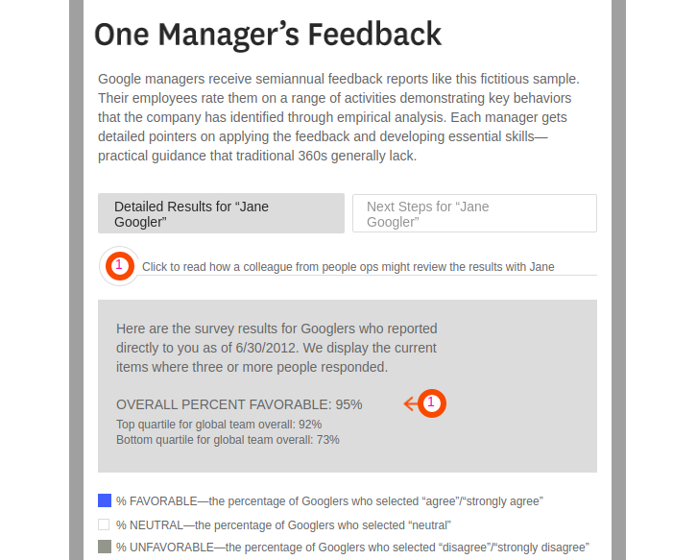

According to an article in Harward Business Review,”From 2010-2012 the UFS and TMS scores rose from 83% to 88% and the lowest-scoring managers were improved the most with the impact of Project Oxygen”
Following research by advisory service CEB,which concluded that 80% of organizations were considering a major change to their performance management systems and 95% of the managers were dissatisfied with the same.
A company named Cargill knew it was the time to make a change.The survey conducted by them stated that 69% of the feedback received was useful for professional development and 70% felt valued of continuous performance discussion with their manager.
The world of HR & Organizational Development strive to find the ‘new shiny’ idea,this research clearly shows that we need to keep up with basics to achieve success.
Google has been named the “Best Company to work for” a total of 7 times by Fortune magazine and Great Place to Work Institute Google received this accolade once again in 2017.
Certain skills are required to translate knowledge into action that results in desirable performance and to become productive.
To wrap up,Project Oxygen serve as an example to find effective managers and teams who make great peer coaches and guide the organization in the correct path without any ambiguity and emerge as the best organization in this fast progressing world.

Slide 16
THANK YOU
-PUJARI VISHNUPRIYA (1KS18CS073)
-R DEKSHITHA (1KS18CS075)
-R PRATIKSHA (1KS18CS076

